Slide 1
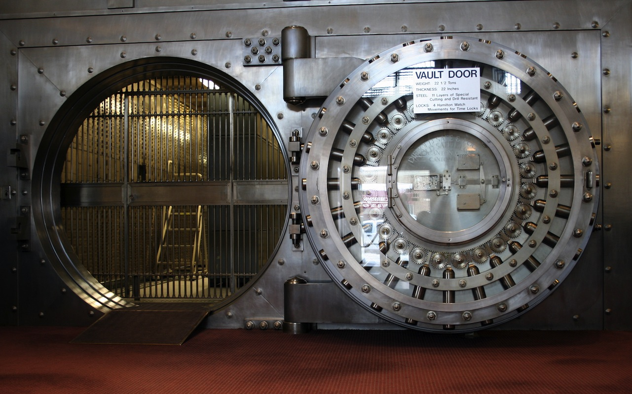
Heist
Team 15

Slide 2
The Story
You are an ordinary man, with honest motives but questionable morals, that has agreed to take part in a bank heist.
Your goal is to manoeuvre through the bank towards the vault, in which you’ll find the riches you desire.
Using a mixture of items the player has purchased during the pre-planning phase, and various items found scattered throughout the bank, the character must find a way to complete the tasks and final goal efficiently.

Slide 3
Defining Features
While text-based games all follow a similar format, this game has some defining features that make it stand out.
Limited Turns: The tasks and final goal (stealing the money), must all be completed within a set number of turns. Failure to complete everything within this limit will result in a failed attempt.
Scaled Victory: Assuming that you have completed the main objective within the set number of turns, the amount of money that you are able to take is based upon how many turns you have remaining. The less turns needed to finish the game = more money, and a higher score!
A rich back story, with a wide variety of interactive options that will influence the final outcome of the game, including a pre-planning phase that allows you to purchase useful items.

Slide 4
Game Mechanics
It is a classic text-based adventure game, programmed using Python.
The basic commands, and clarity of objectives, makes this game suitable for players of all abilities.
Two main stages to the game: the “pre-planning”, and the “main body.” The reason for this is to create a sense of realism, and it will hopefully engage the player, as they are not simply handed the tools required for an easy victory. The limit on items you are able to choose and carry adds a sense of strategy to the game, rather than mindless movement around a map.
Attributes
A leader board that will be ranked according to how much money you are able to steal from the bank. This means that the game can be played through multiple times, so that you can try to beat your personal best.

Slide 5
Why should you choose this game?
If you are looking for a game with an exciting story, with the freedom to affect the outcome depending on your personal decisions, then this is the game for you!
Heist takes the stereotypical text-based adventure game format, but spices it up with the use of a modern, and somewhat realistic setting, alongside characters you can empathise with.
Do you think you could carry out a successful bank heist? The only way to find out is to try this game!

